Slide 1
Practice 1
LAB Practice on GPIO Port

Slide 2
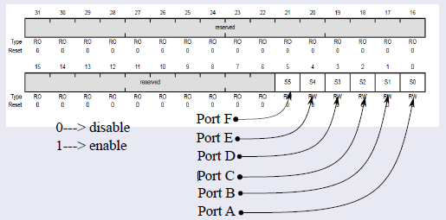
Clock Gating Register

Slide 3
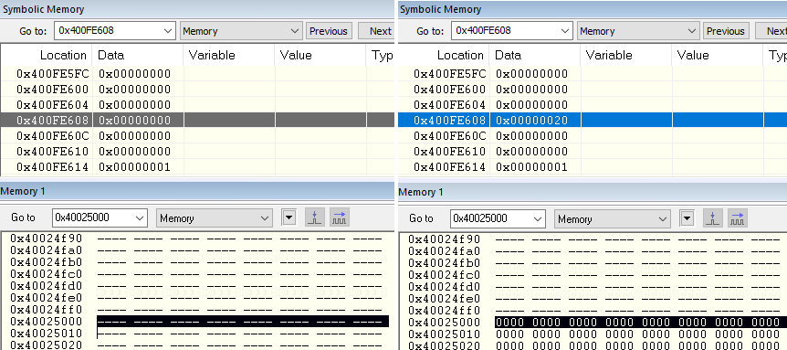
Before and After Setting Clock Gating Register

Slide 4
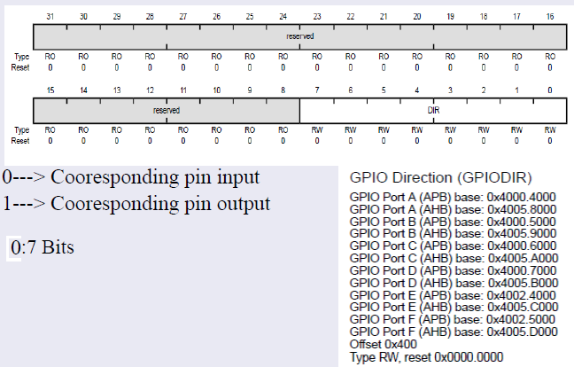
Direction Register

Slide 5
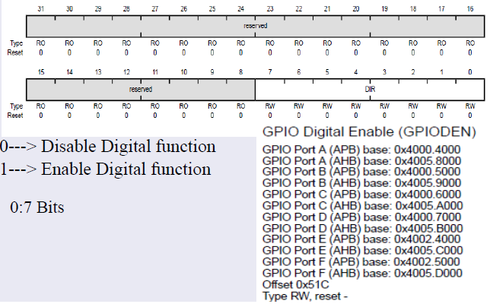
Digital Function Register

Slide 6
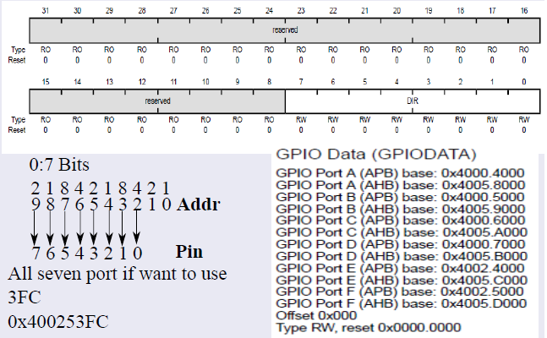
Port Data Register

Slide 7
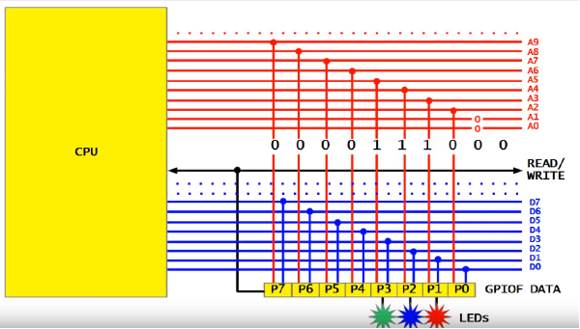
Addressing Each Bit in Data Register

Slide 8
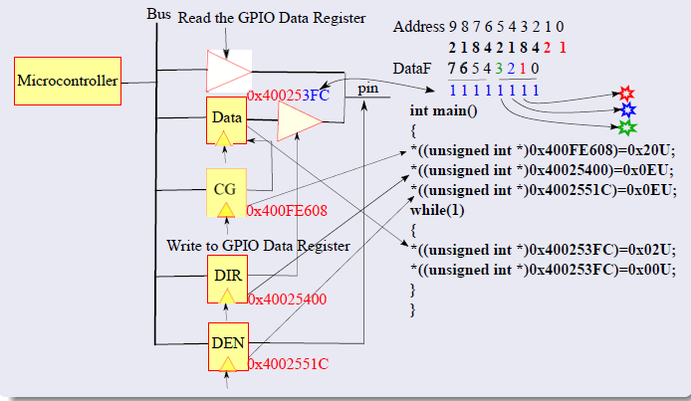
Final Program with RTL Logic

Slide 9
Practice Problem for Todays Lab
Write a register level program to calculate each bit address of Port F Data register, where the red, green, blue LEDs are connected. Also light each led with different delay 1 sec, 2sec, 3 sec.
How many cycle do we need to create the delay of 1 sec, 2 sec, and 3 sec. Read the datasheet and identify the clock frequency on the GPIO port.
Upload your practice in Google drive: https://drive.google.com/drive/folders/17qQZcQr8cAZn7apGTpx_QNbn-r6AkzoO?usp=sharing

